Slide 1
Linux OS Configuration 2

Slide 2
Pluggable Authentication Module (PAM)
Set of libraries used to manage user authentication
Files
/etc/pam.d/common-password
/etc/pam.d/common-auth
/etc/login.defs (password expiry, not PAM)
[service] type control module-path [module-arguments]
service: application name
type: module type
control-flag: behavior should the module fail to authenticate
module: the filename or pathname of the PAM
module-arguments: space separated list of tokens
apt-get install libpam-cracklib
Enforces stricter passwords

Slide 3
PAM - /etc/pam.d/common-password
Password configuration (length, complexity, etc.)
pam_unix.so
remember=5
remember last 5 passwords
minlen=8
minimum pw length
pam_cracklib.so
ucredit=-1 lcredit=-1 dcredit=-1 ocredit=-1
upper, lower, number, symbol

Slide 4
PAM - /etc/pam.d/common-auth
auth required pam_tally2.so deny=5 onerr=fail unlock_time=1800
Add to end of file
number of allowed failed logins = 5
account lockout duration = 1800 seconds (30 minutes)
Don't get locked out

Slide 5
/etc/login.defs
PASS_MAX_DAYS 90
Maximum password duration
PASS_MIN_DAYS 10
Minimum duration before password expires
PASS_WARN_AGE 7
Days before expiration to warn users

Slide 6
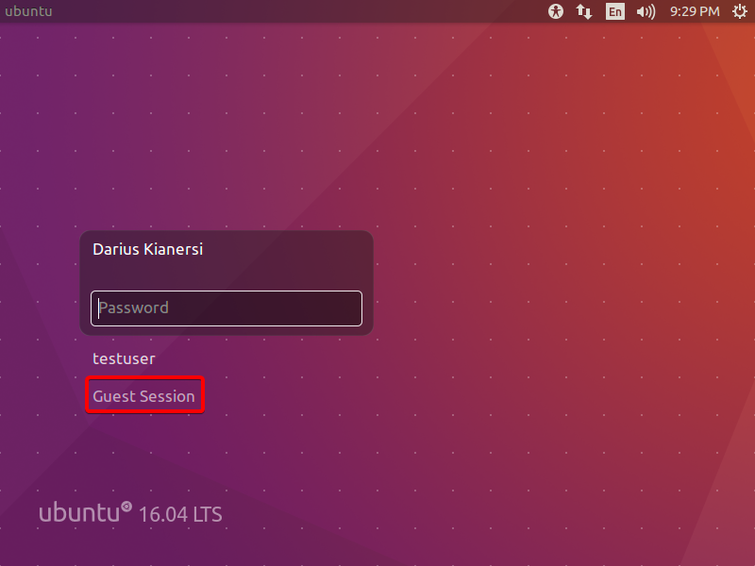
Lightdm
Ubuntu display manager
/etc/lightdm/lightdm.conf, /etc/lightdm/lightdm.conf.d/
allow-guest=false
service lightdm restart

Slide 7
Sysctl (/etc/sysctl.conf)
Modifies attributes of the system kernel
Notable configuration:
net.ipv4.tcp_synack_retries = 2
net.ipv4.tcp_rfc1337 = 1
kernel.randomize_va_space = 2
net.ipv4.icmp_echo_ignore_broadcasts = 1
sysctl -p

Slide 8
IP Spoofing
Sending packets with fake IP addresses
Often used in DDoS attacks
/etc/host.conf
order bind,host
specifies order in which host lookups are performed
nospoof on
attempts to prevent hostname spoofing
multi off
library only returns the first valid address for a host

Slide 9
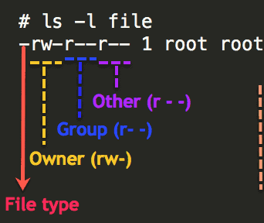
File Permissions and Ownership
ls -l FILE
chmod [-R, --recursive] PERMS FILEPATH
user, group, other -- ugo
read, write, execute -- rwx
octal
read - 4
write - 2
execute - 1
Ex: chmod o-rwx,g=wx out.txt
chown [-R, --recursive] USER:GROUP FILEPATH

Slide 10
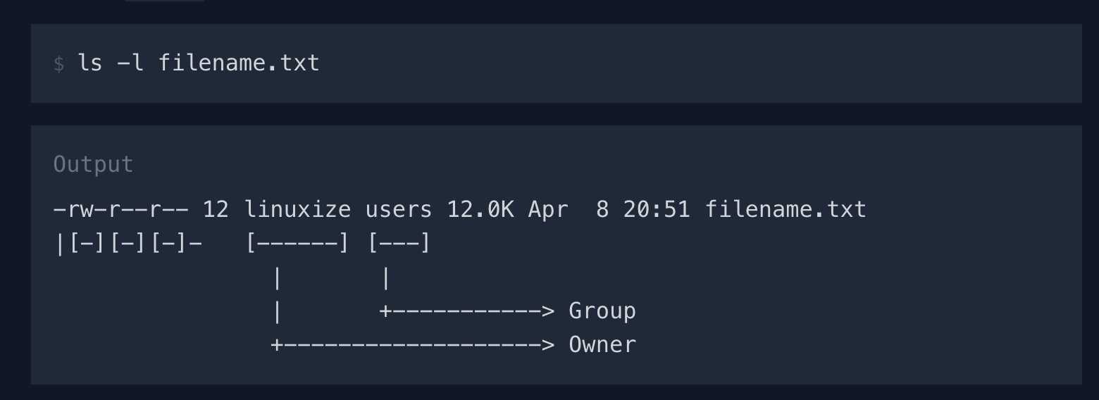

Slide 11
File Permissions Examples
Instruction | rwx | octal
SET: user - read, write, execute group - execute other - none | u=rwx,g=x,o= | 710
SET: user - read group - write other - execute | u=r,g=w,o=x | 421
SET: user - read, write, execute group - read, write, execute other - read, write, execute | ugo=rwx | 777
ADD: other - read, execute | o+rx | -

Slide 12
Permissions Cheat Sheet
/etc/passwd 644 root:root
/etc/shadow 640 root:shadow
/etc/group 644 root:root
/etc/gshadow 640 root:shadow
/etc/sudoers 440 root:root

Slide 13
Practice
1. Make file "run.sh" executable for every user
2. Make directory "dir1" (and all subdirectories/files):
readable by all users
executable only by users within the group
writable only by the owner
3. Make file "test.txt" have owner "radius" and group "admins"

Slide 14
Practice Answers
1. chmod ugo+x run.sh
2. chmod -R u=rwx,g=rx,o=r dir1 OR chmod -R 754 dir1
3. chown radius:admins test.txt

